Slide 1
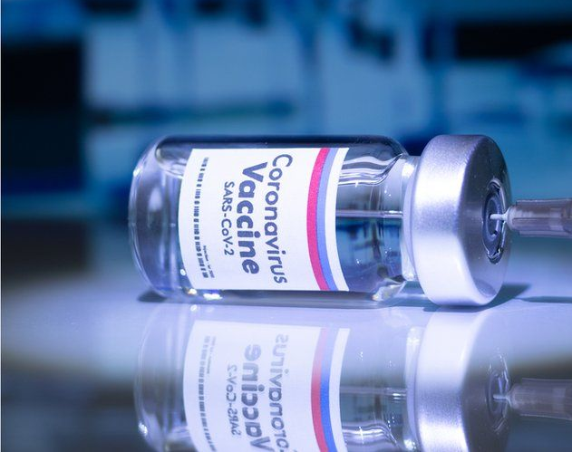
Covid – 19 Vaccine Adverse Reaction
Kossmann, Mondin, Rivera, Sasson, Taleb

Slide 2
Presentation Agenda
Data Preprocessing
Data Exploratory Analysis
Supervised Machine Learning
Unsupervised Machine Learning

Slide 3
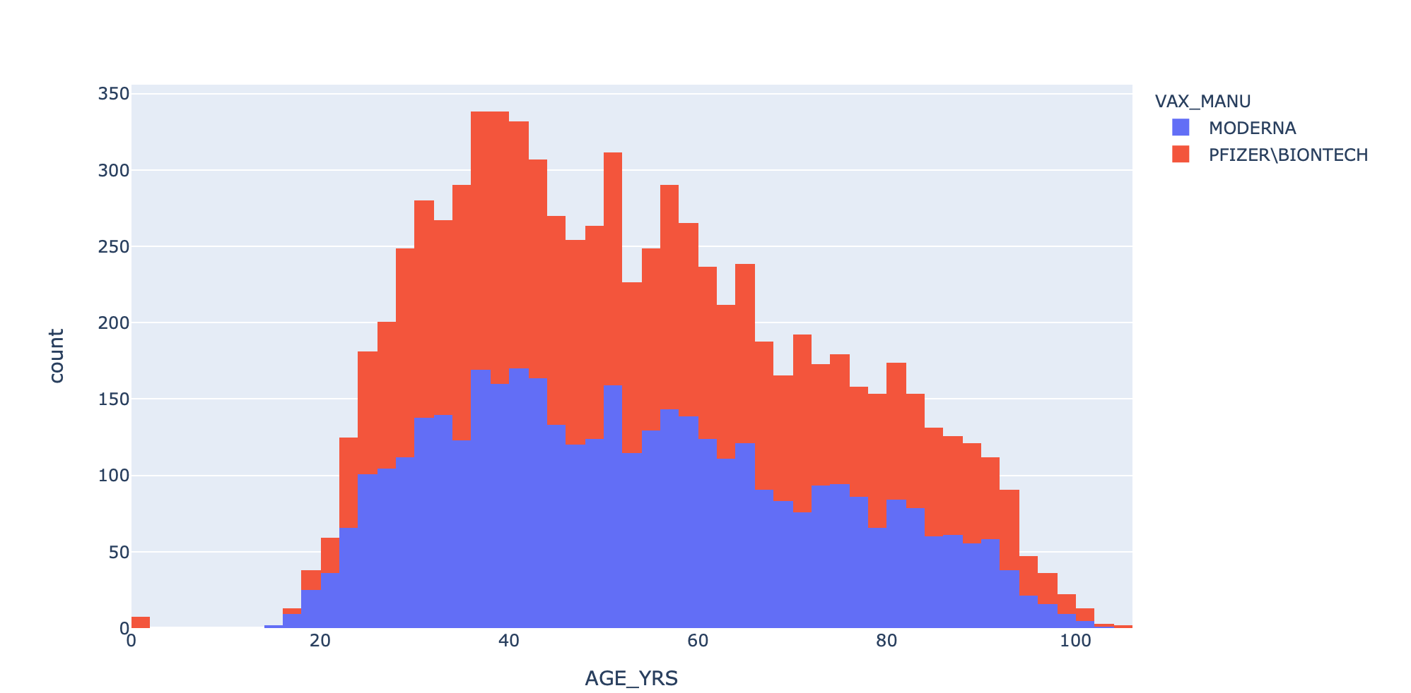
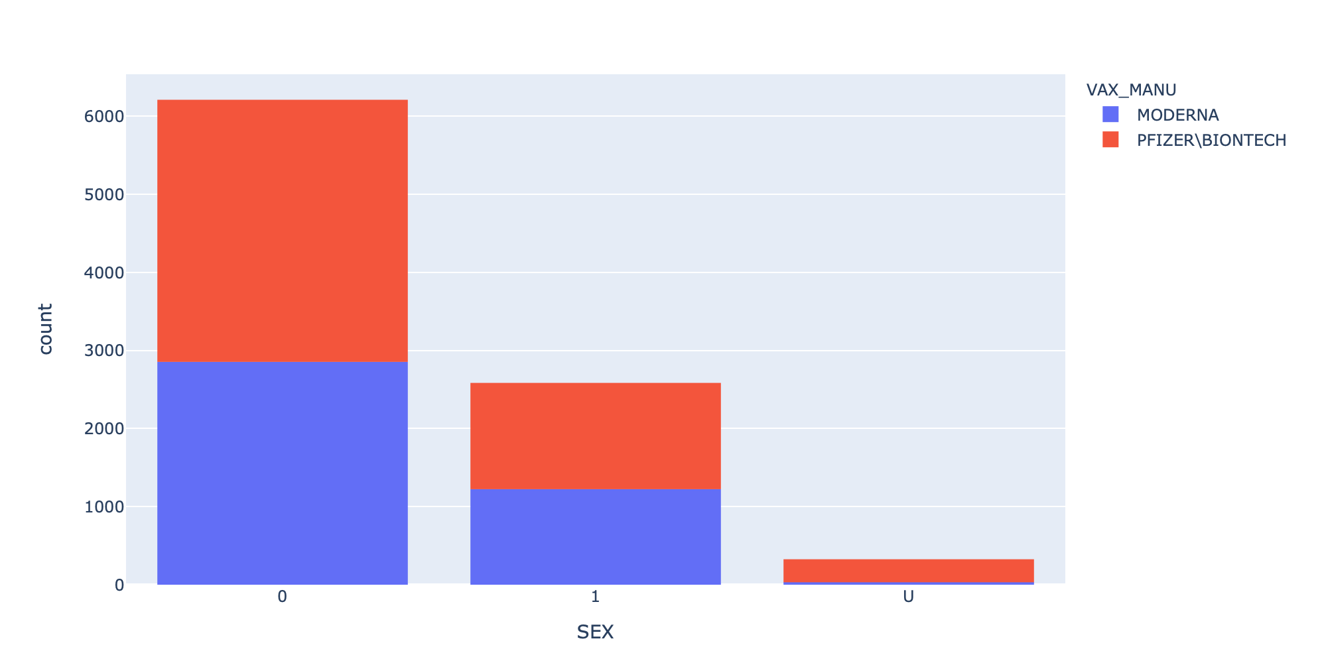
Distribution of Vaccine based on Age and Sex
30 –50 age has highest number of vaccinated people
Same distributions for both vaccines
Females have highest number of vaccinated people
Same distributions percentages per sex

Slide 4
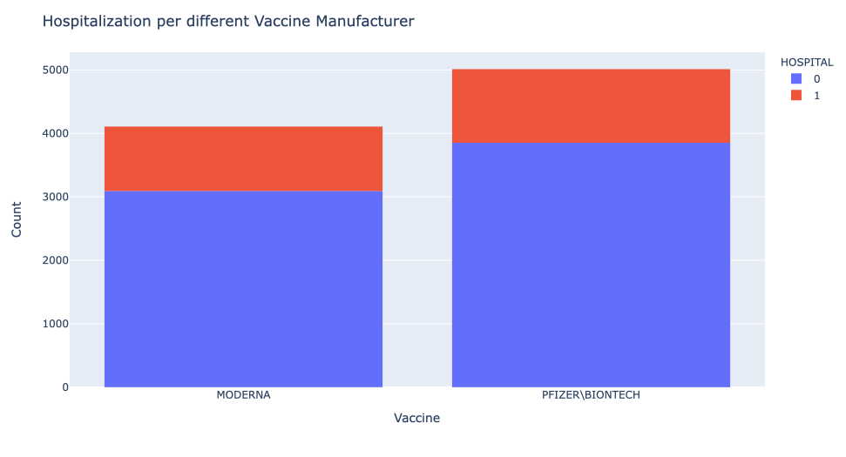
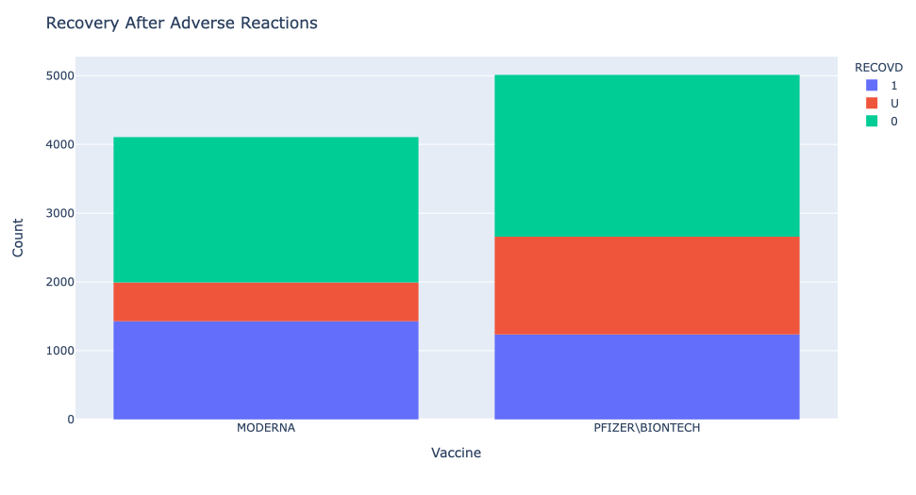
Hospitalization and Recovery per Vaccine Type
0 = Not Hospitalized
0 = Not Recovered
1 = Hospitalized
1 = Recovered

Slide 5
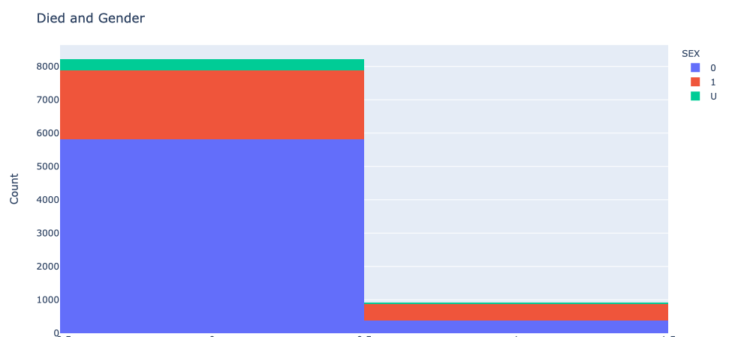
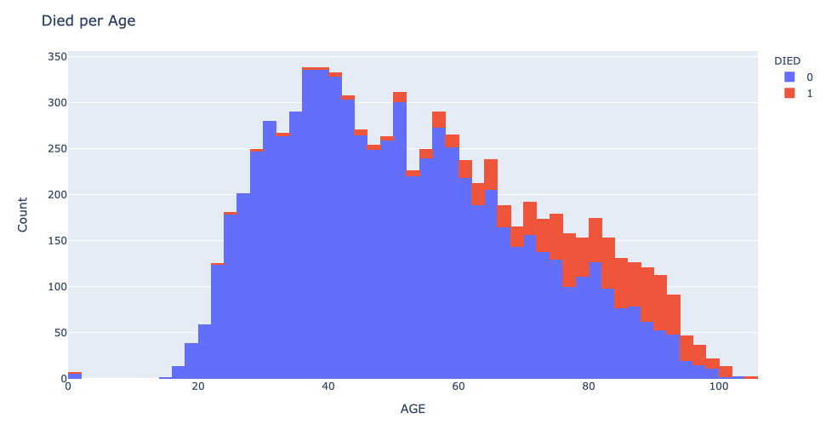
Died Count per Gender and Age
Not Dead
Death
Blue is not dead
Red is dead
Blue is Woman
Red is Man
Green is Unknown

Slide 6
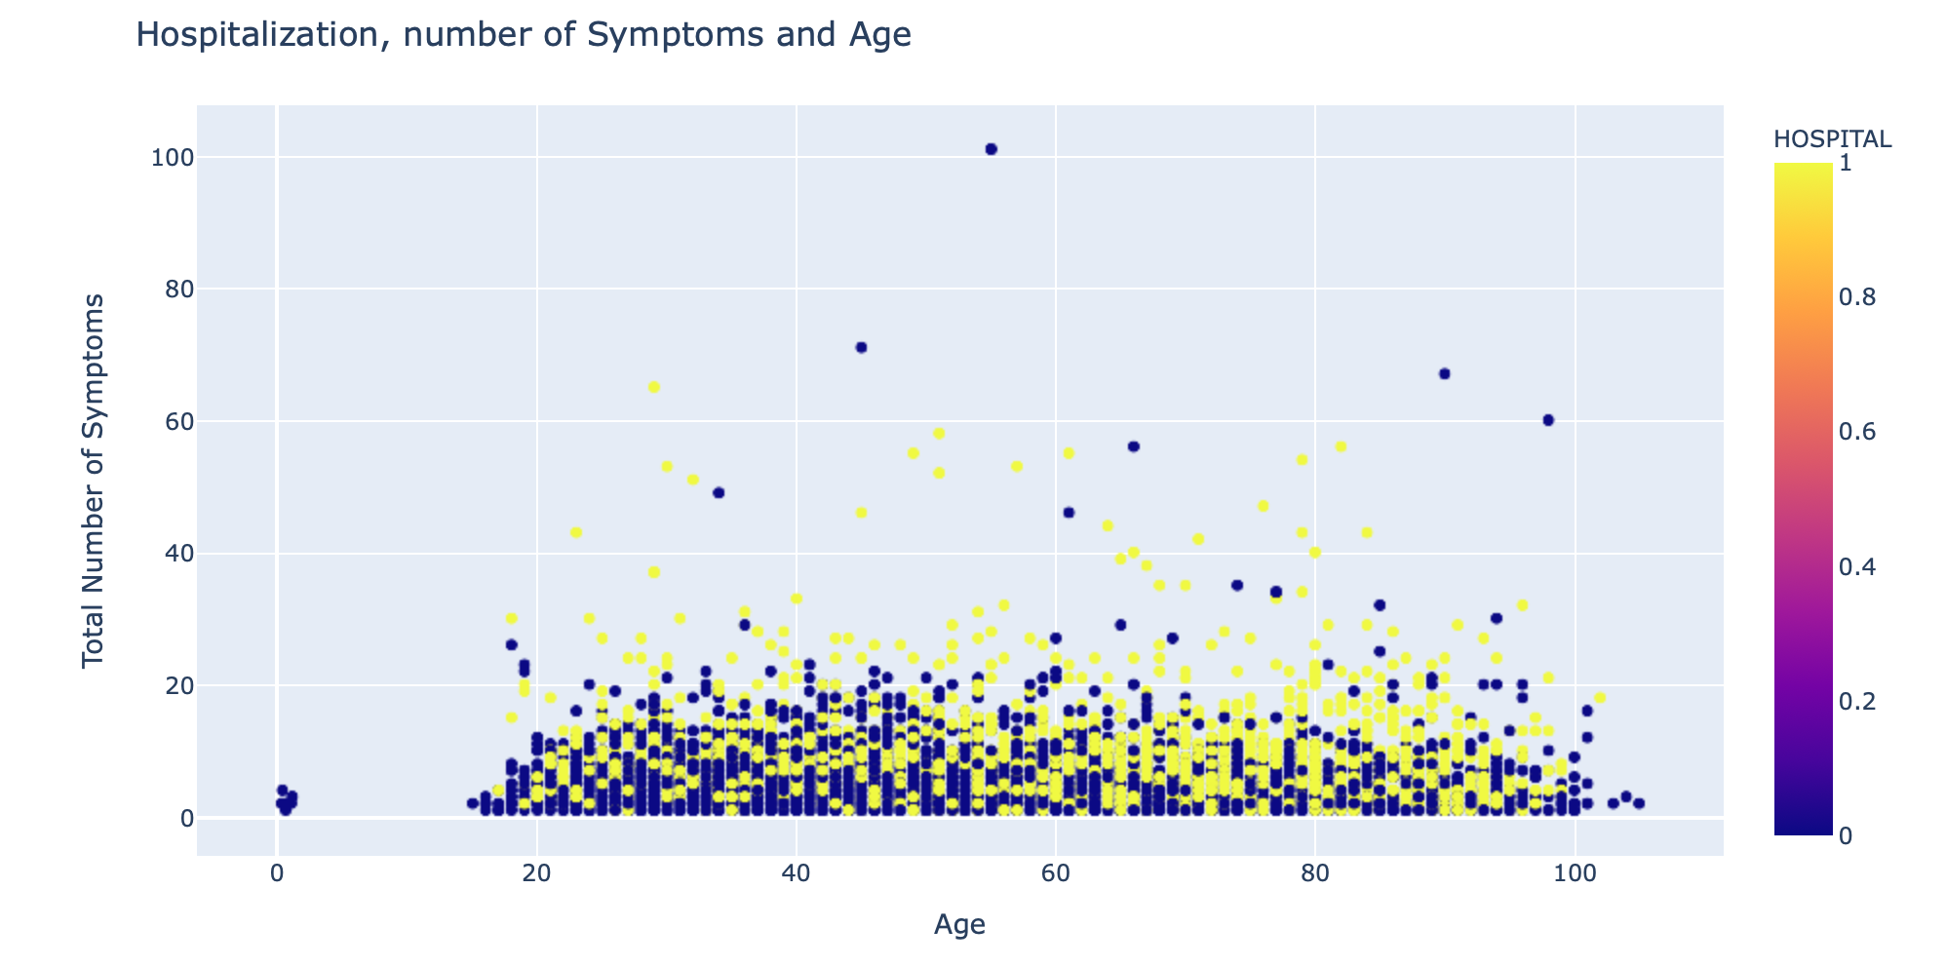
Hospitalization Rate based on Symptoms and Age

Slide 7
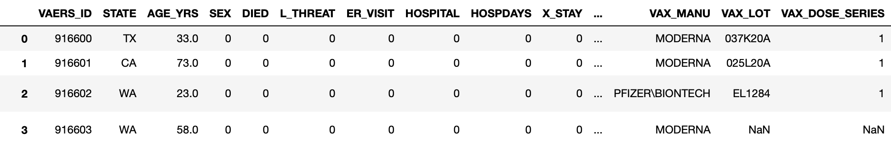
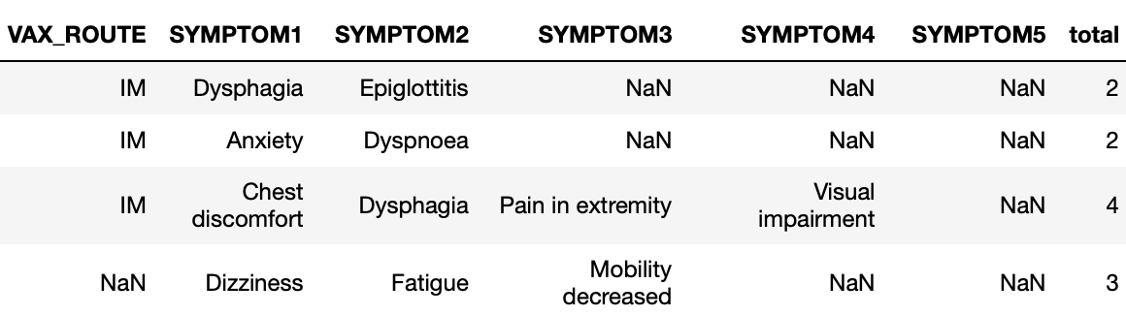
Data Cleaning – Visualization Dataset
First dataset Cleaning
Deleted Symptoms columns and made a count of the total symptoms per person
Filled some NA with 0
Created a variable showing the difference between the vaccination day and death day
Dropped vaccination day and death date
Finally, merged the three datasets only for COVID 19 vaccines patients this is primary used for data visualization

Slide 8
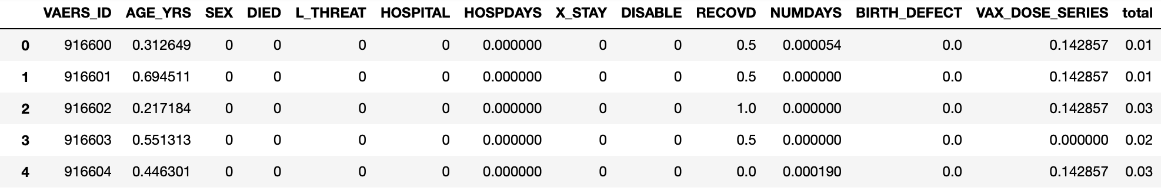
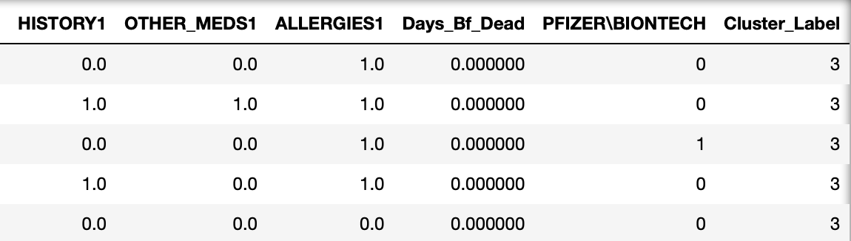
Data Pre-Processing – Modeling Dataset
Second Dataset Cleaning
Dropped the unnecessary variables for the models
Changed the strings to numeric
Created all texts with no, non or unknown into null values, and text to 1
Used the History, Other_Meds and allergies columns and merged the binary dummies to the dataset.
Scaled all culmns related to days and the age so we have everything in 1-0 scale

Slide 9
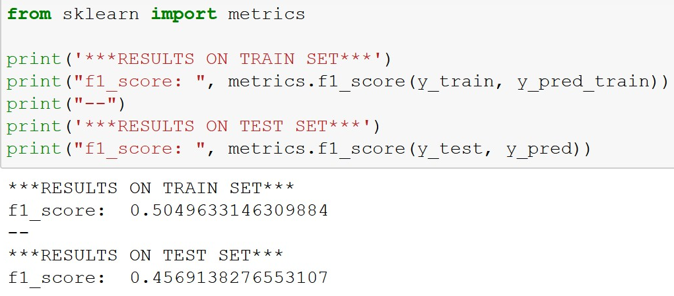
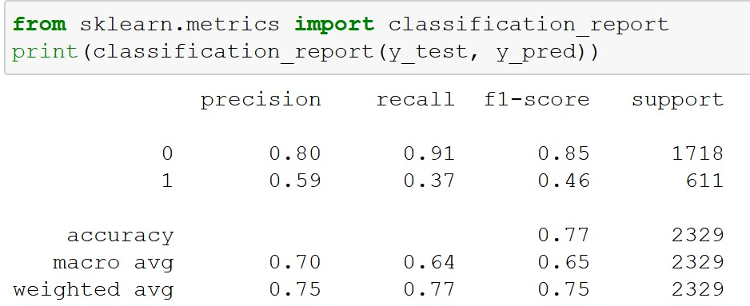
Supervised Machine Learning
Model Type: Decision Tree model
Target Prediction: Hospital
Number of Variables: 11
Most explanatory variables:
Total
History1
Other Meds
Allergies1

Slide 10
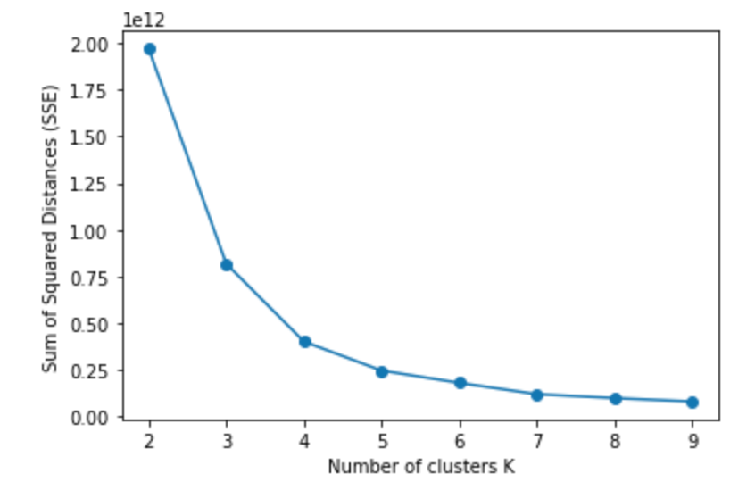
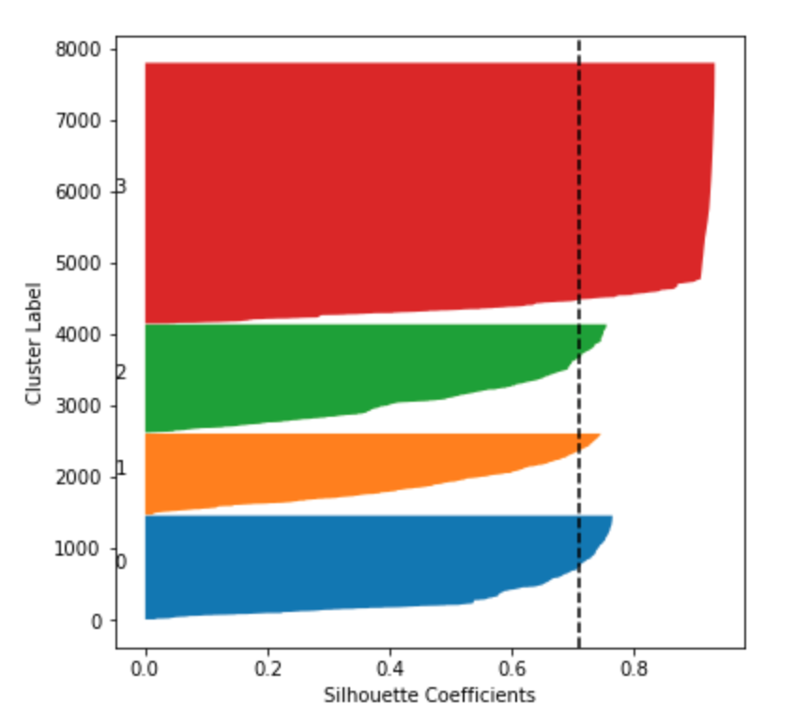
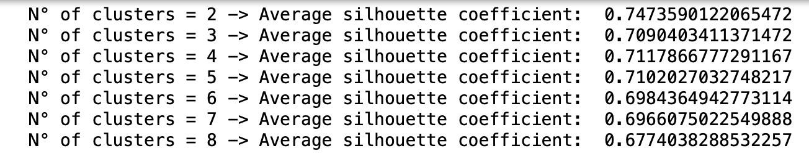
Unsupervised Machine Learning

Slide 11
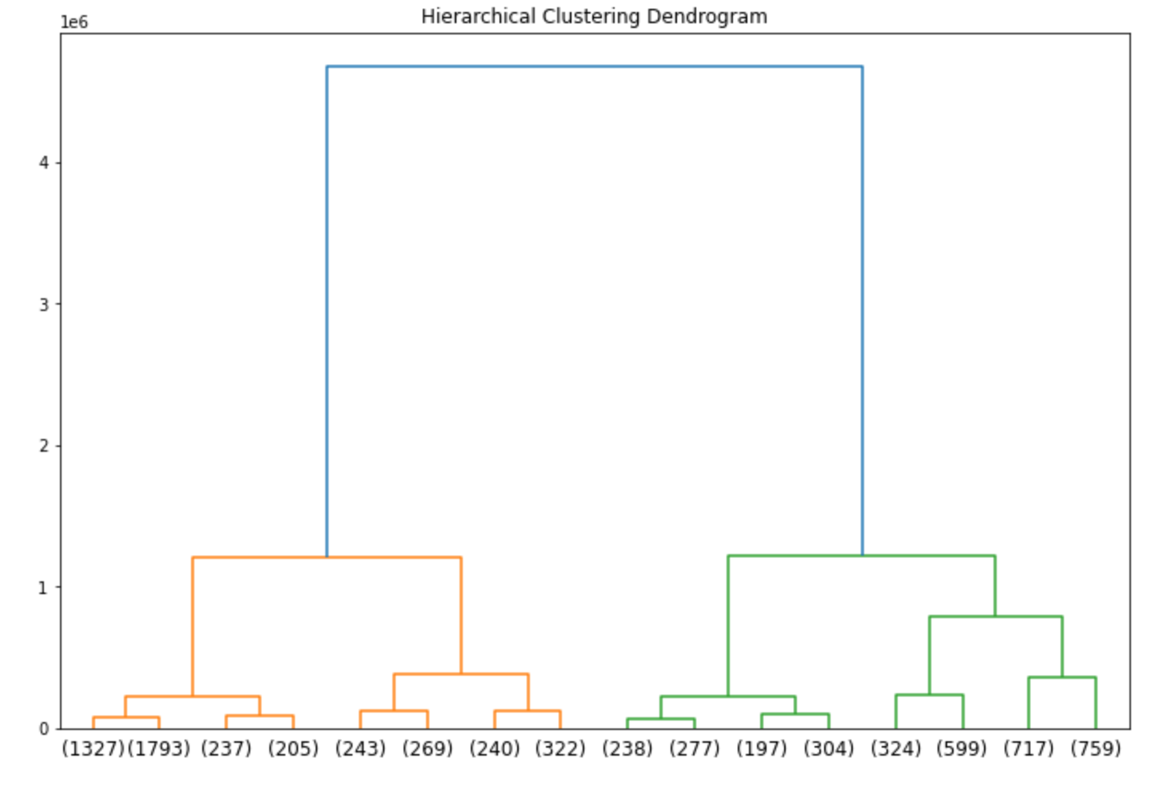
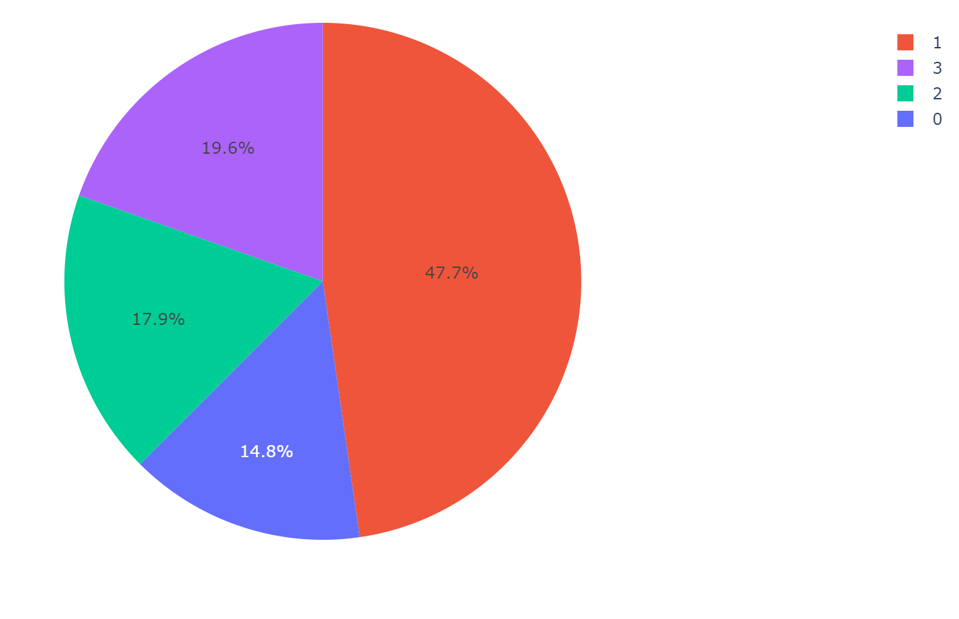
Unsupervised Machine Learning: Hierarchical Clustering Dendrogram

Slide 12
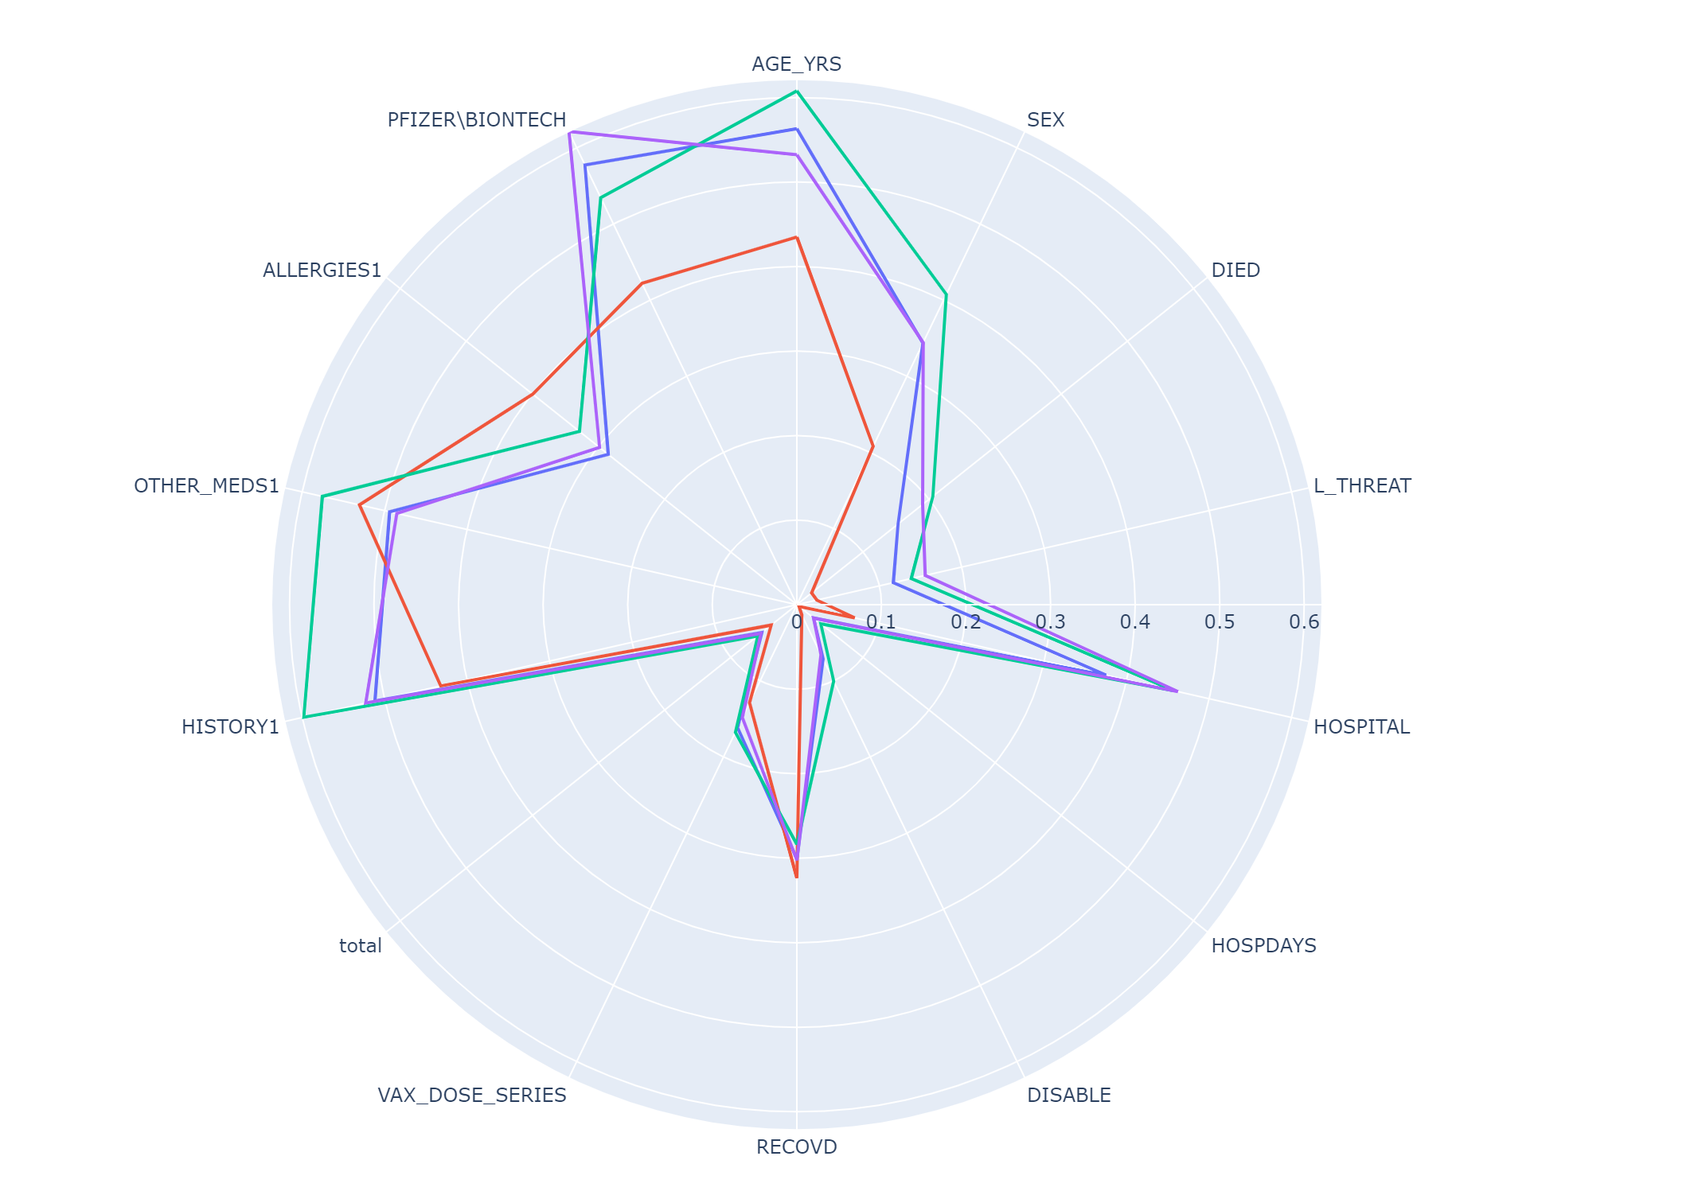
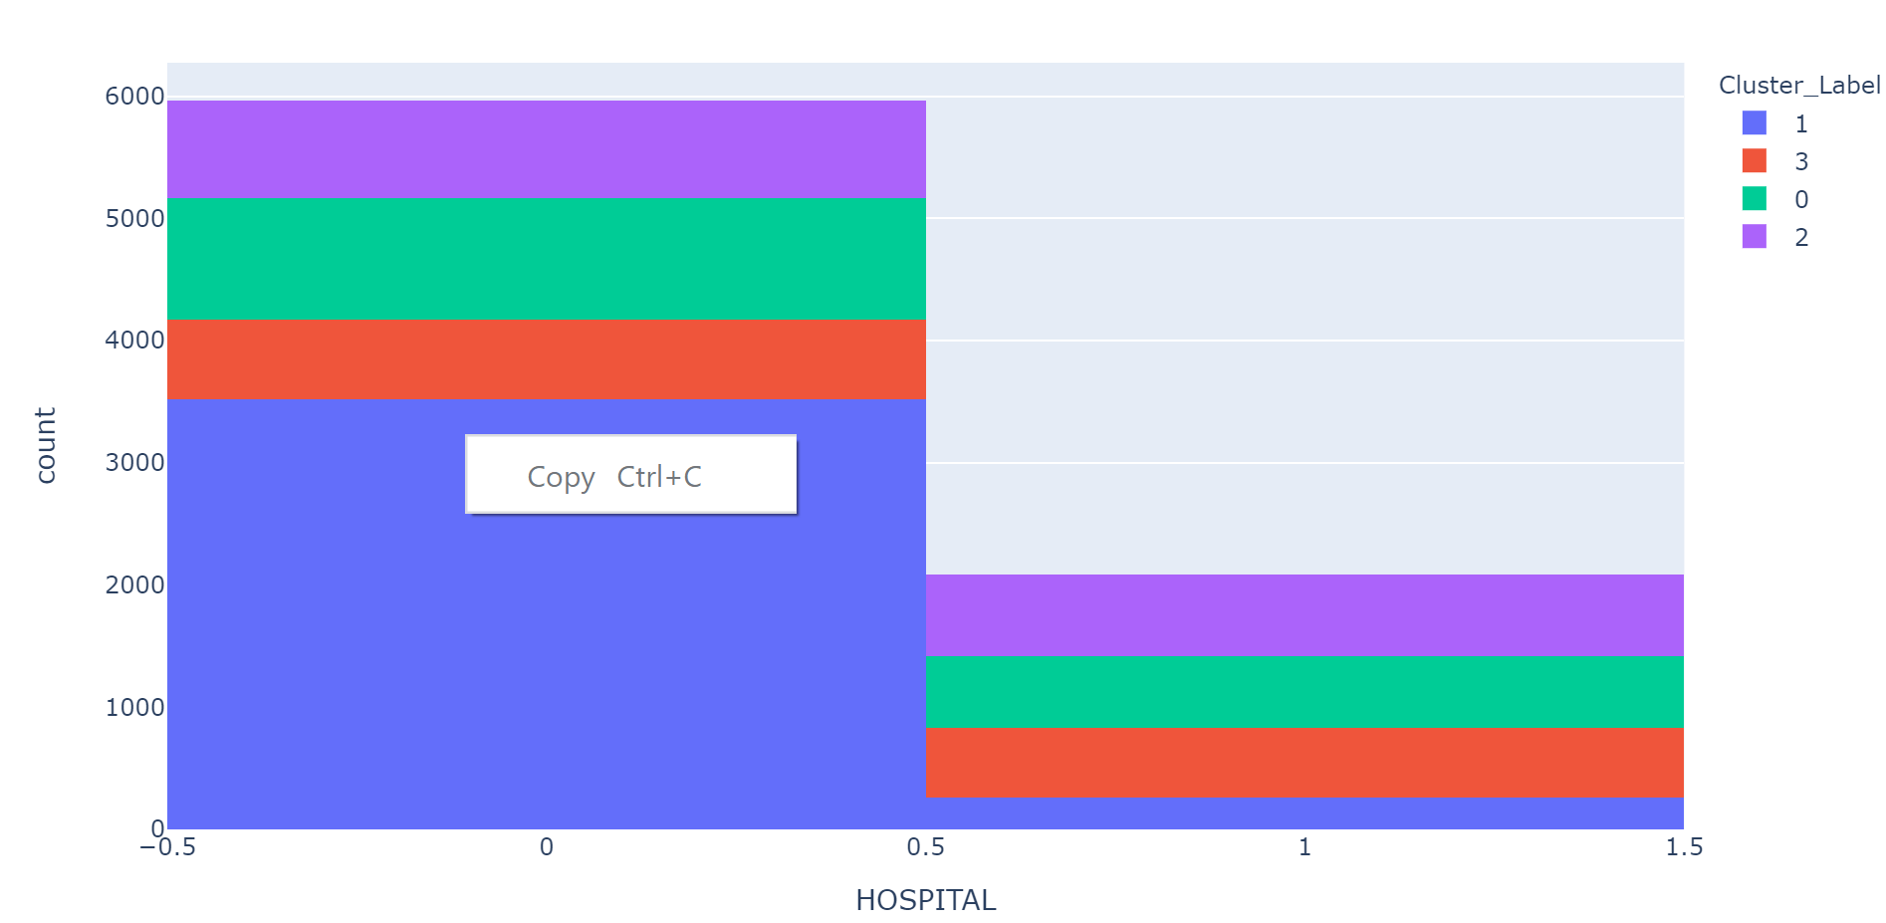

Unsupervised Machine Learning: Clusters Analysis

Slide 13
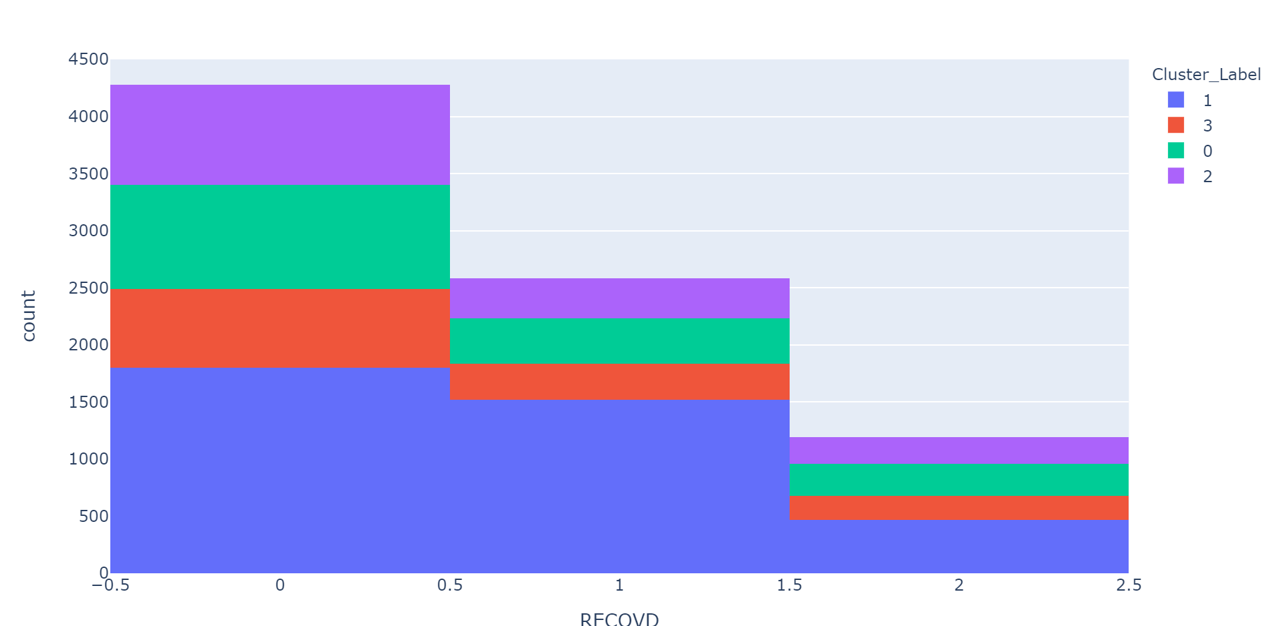
Unsupervised Machine Learning: Clusters Analysis

